Slide 1
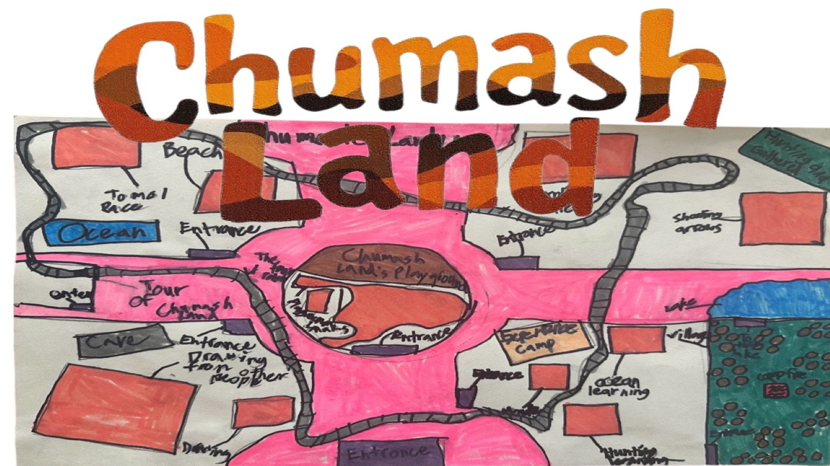

Slide 2
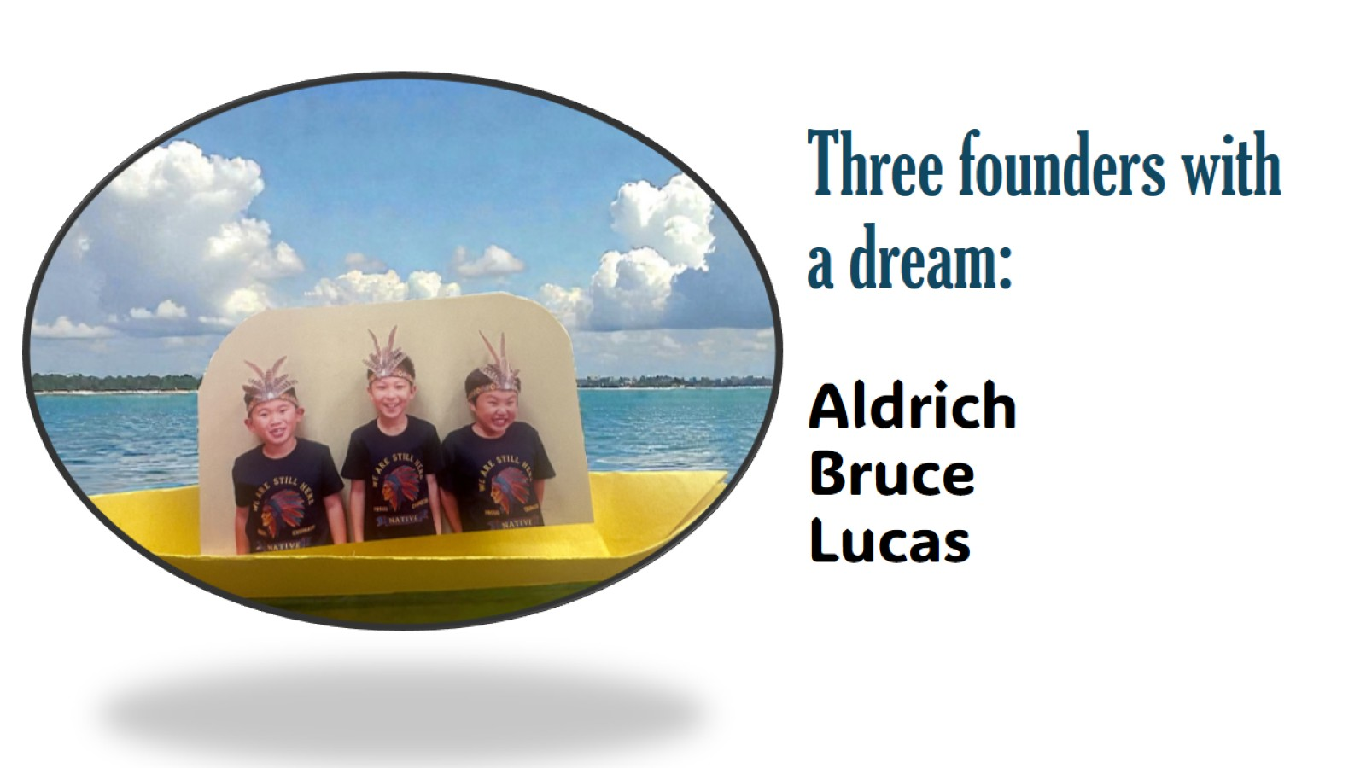
Three founders with a dream: Aldrich Bruce Lucas

Slide 3
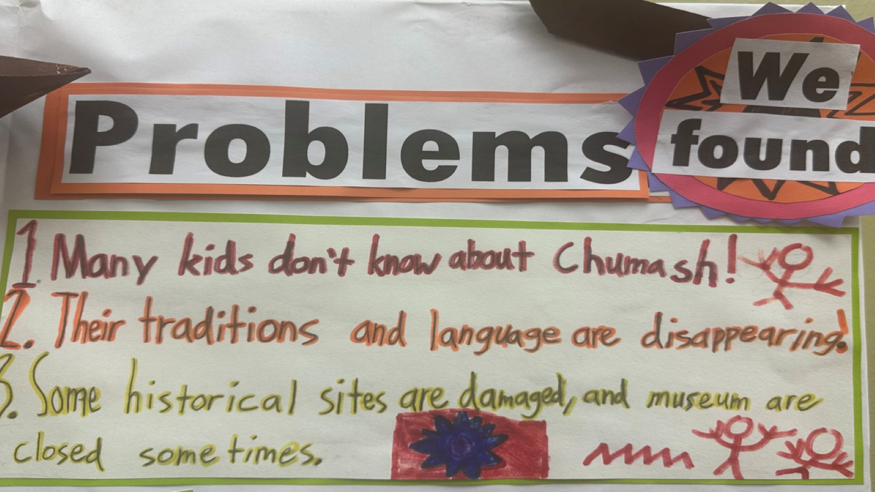

Slide 4
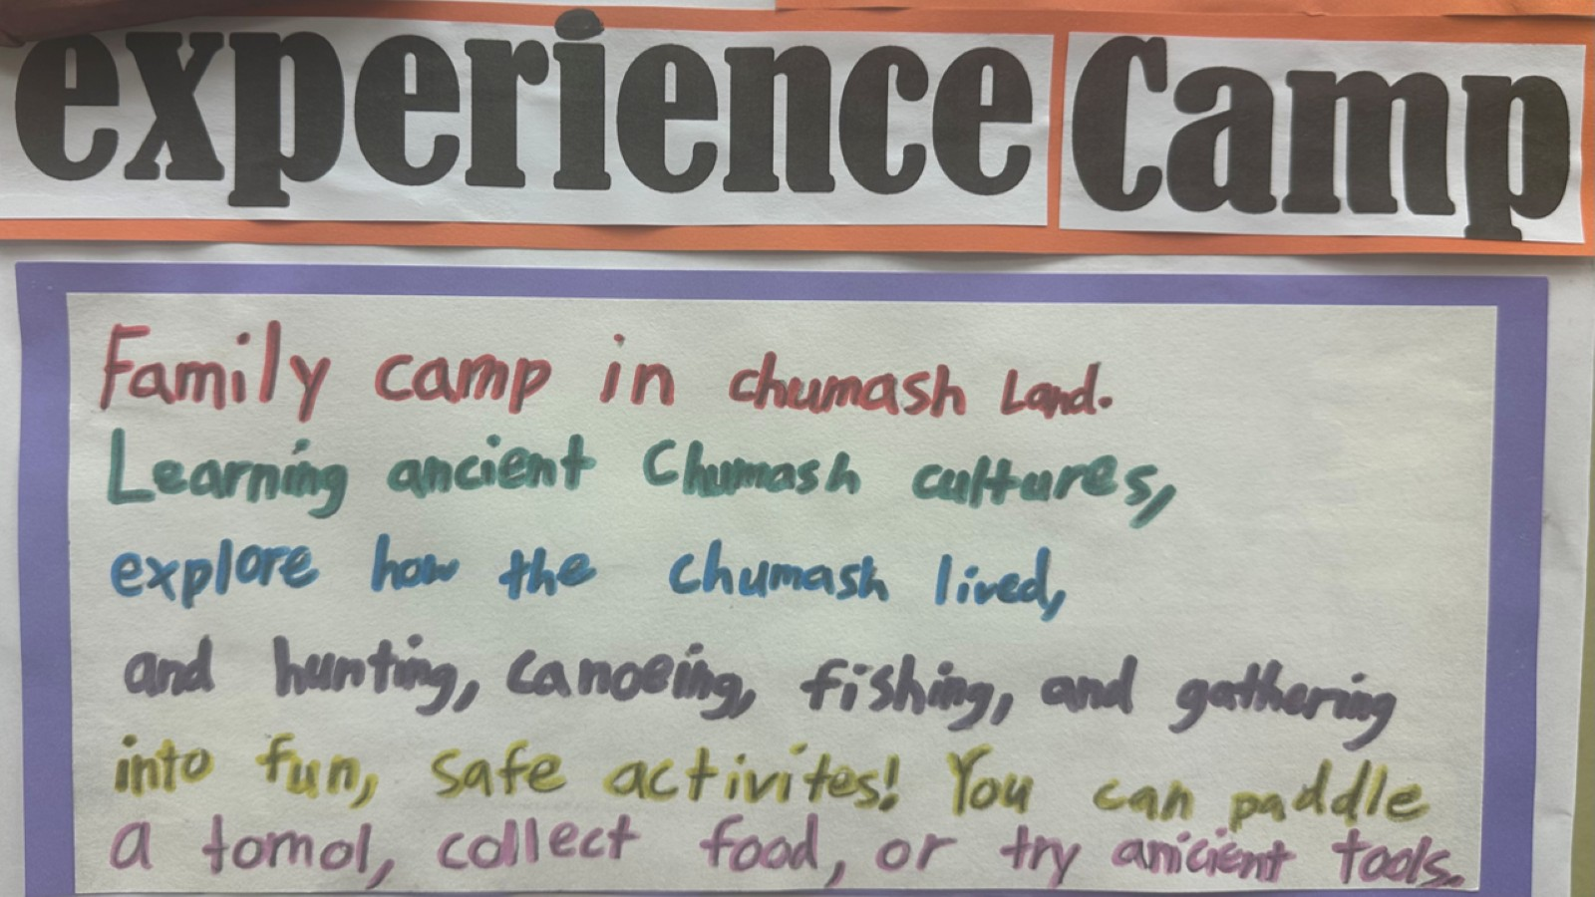

Slide 5
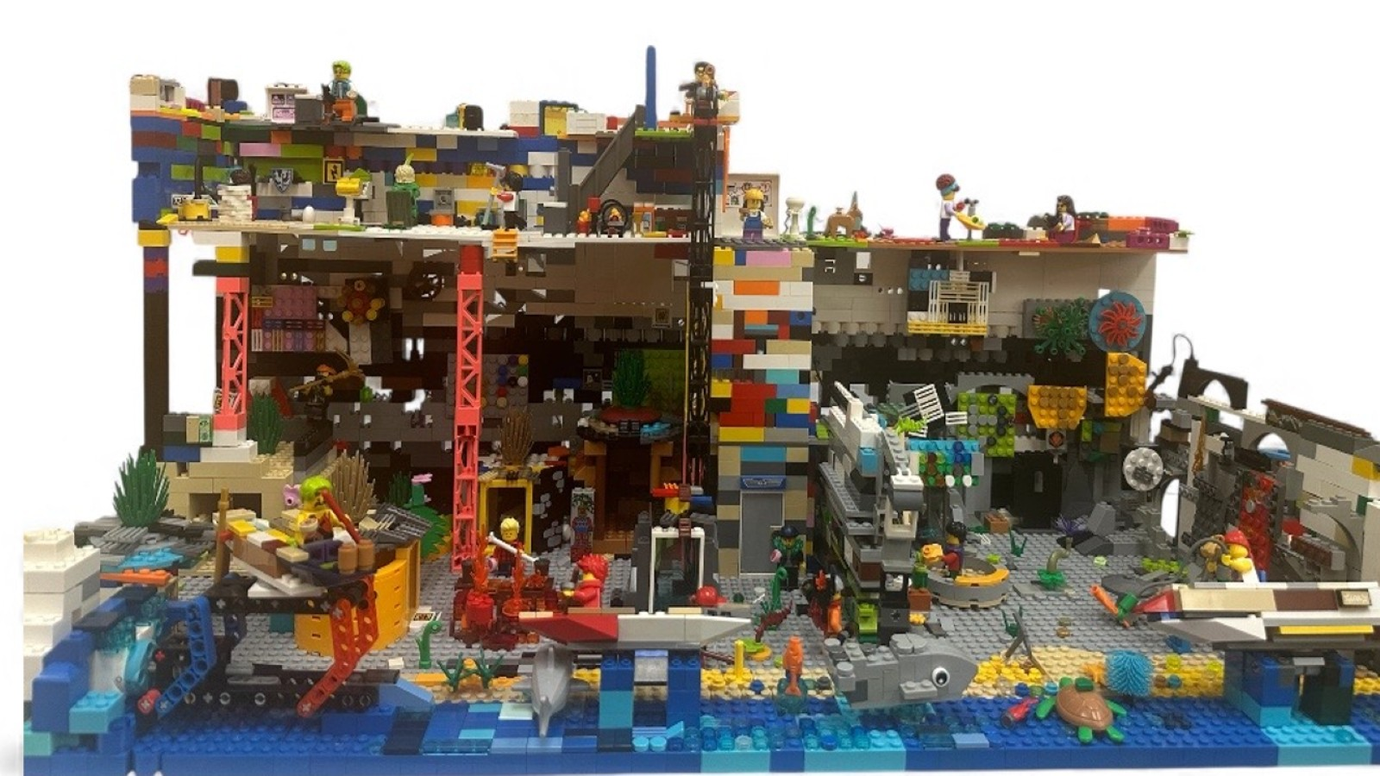

Slide 6
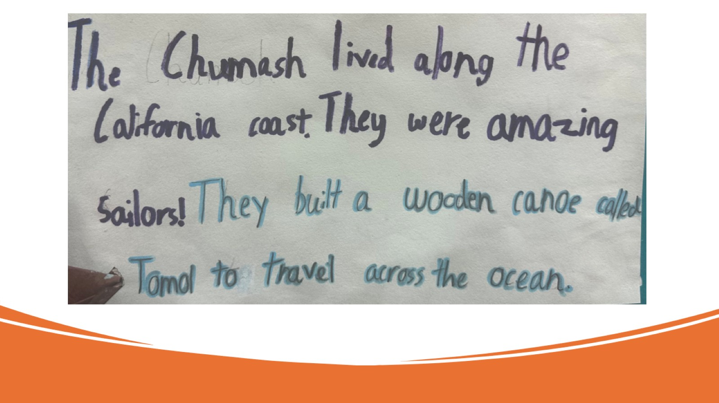

Slide 7
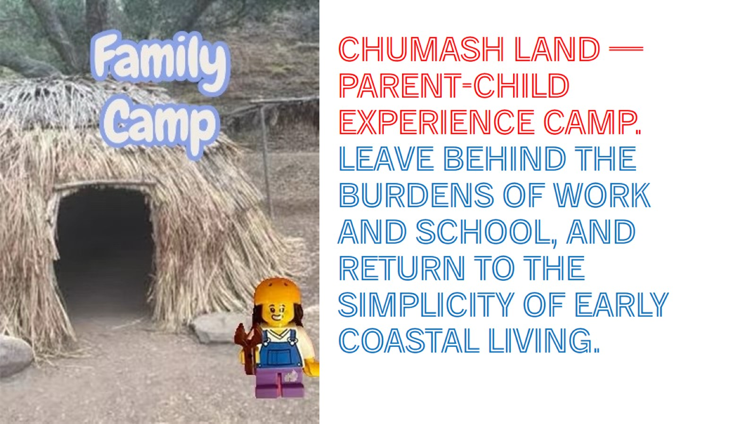
Chumash Land — Parent-Child Experience Camp. Leave behind the burdens of work and school, and return to the simplicity of early coastal living.

Slide 8
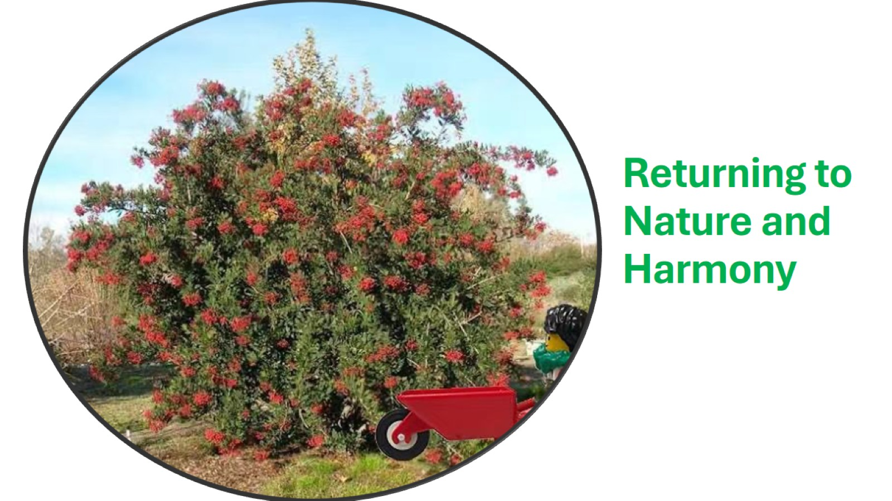
Returning to Nature and Harmony

Slide 9
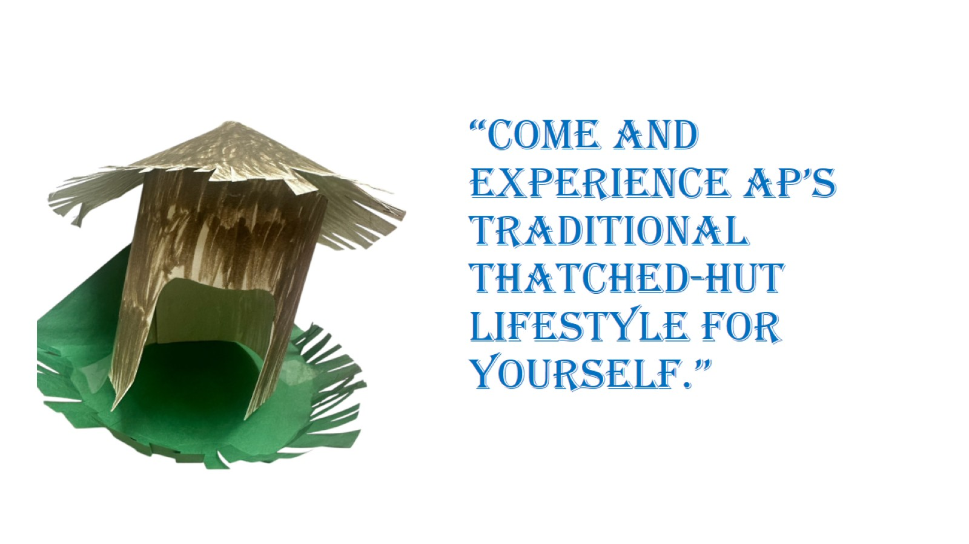
“Come and experience AP’s traditional thatched-hut lifestyle for yourself.”

Slide 10
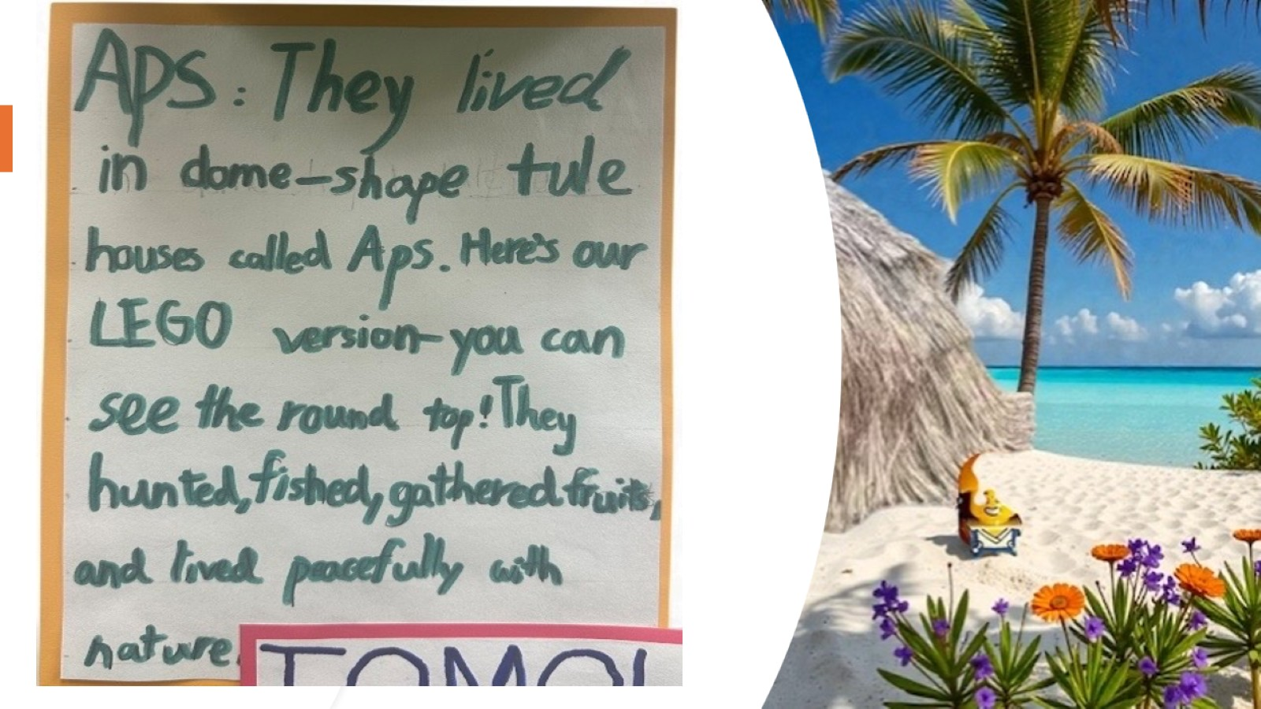

Slide 11
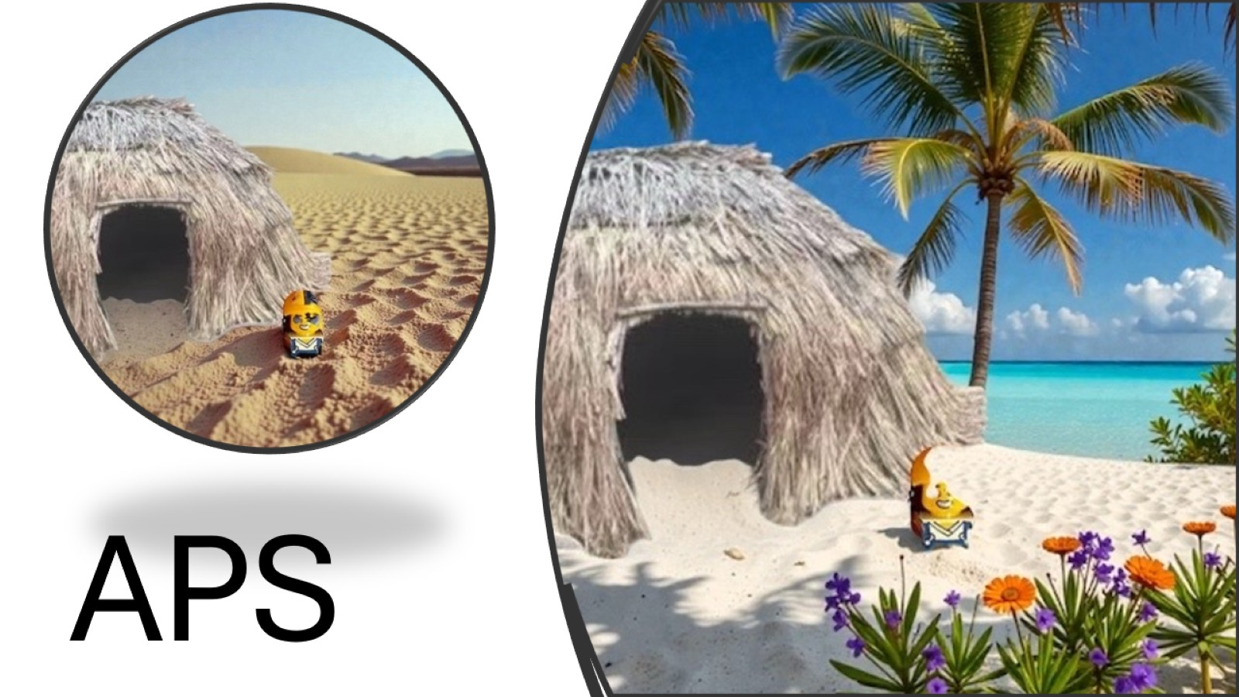
APS

Slide 12
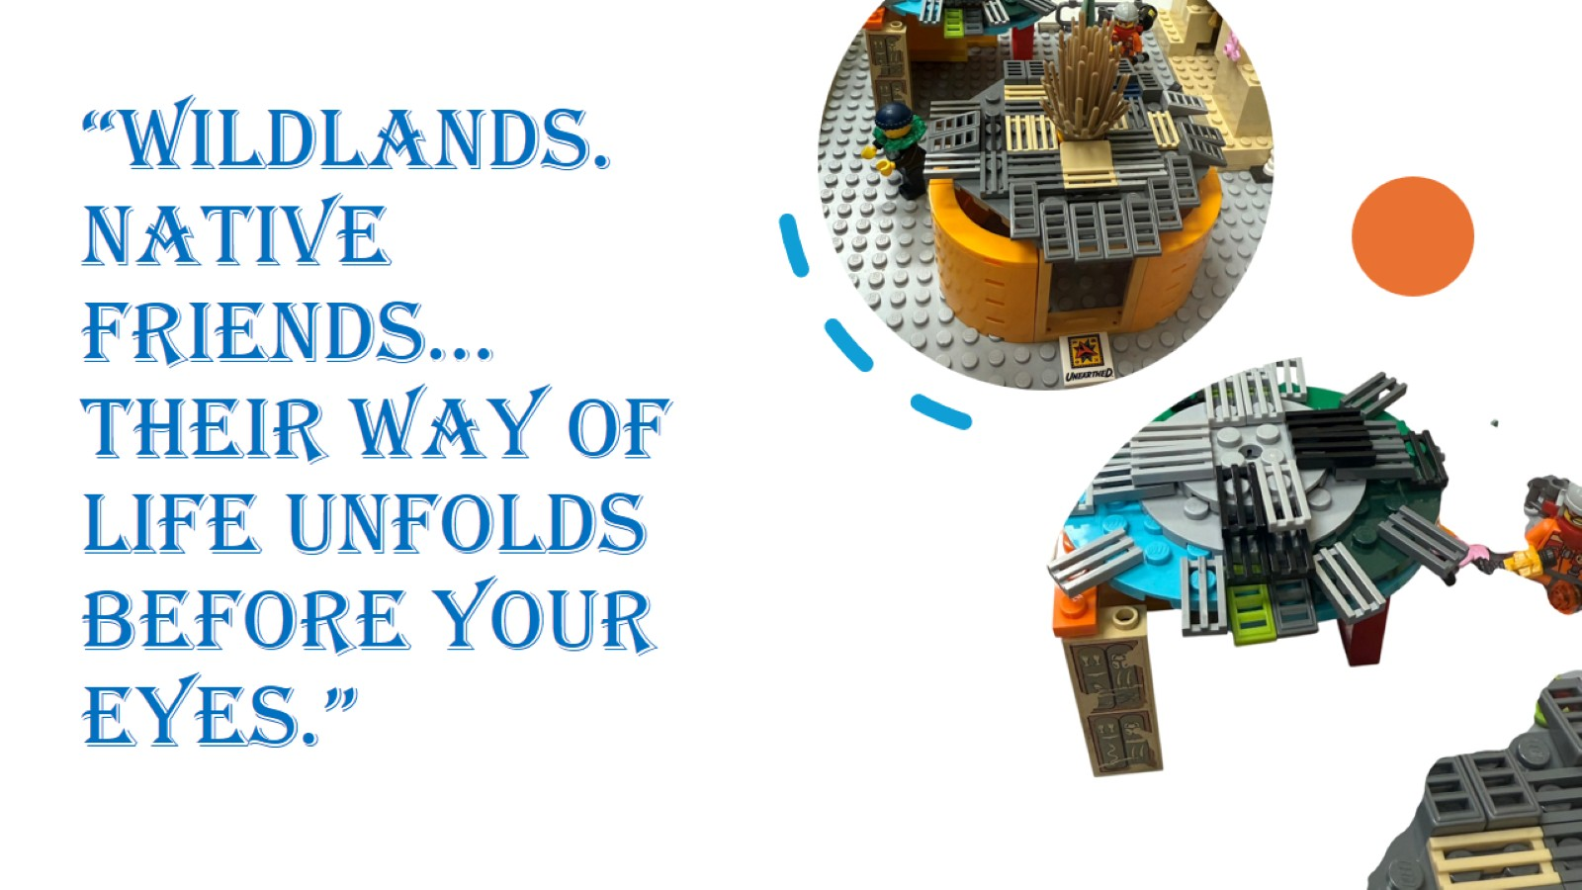

Slide 13
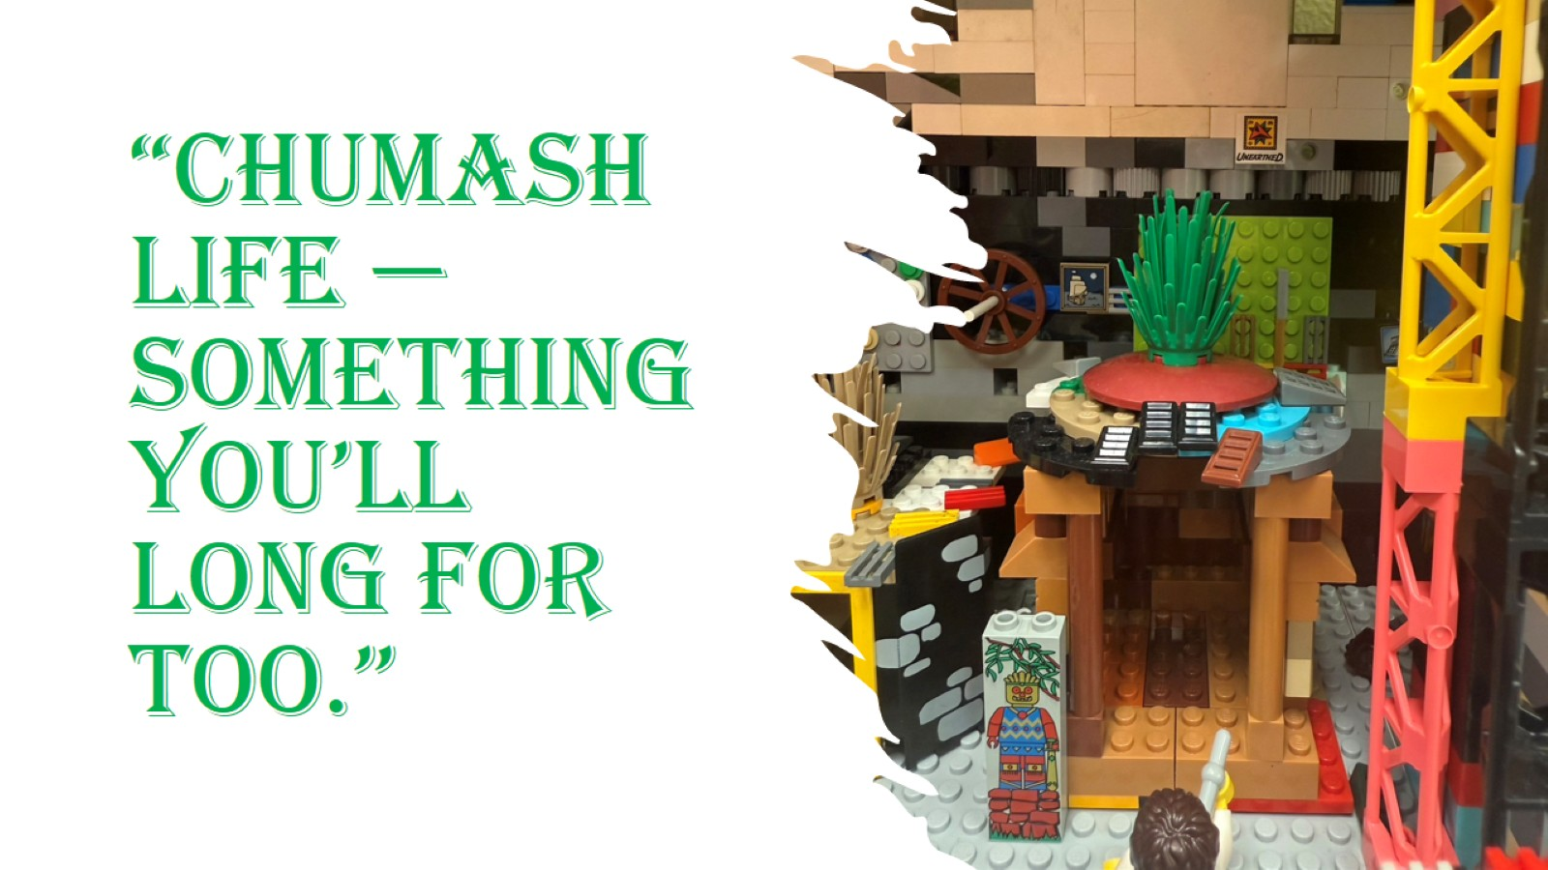

Slide 14

Campfire Nights: Celebrating Family Life and Living Together in Harmony

Slide 15

“Life is art; art is life.”

Slide 16
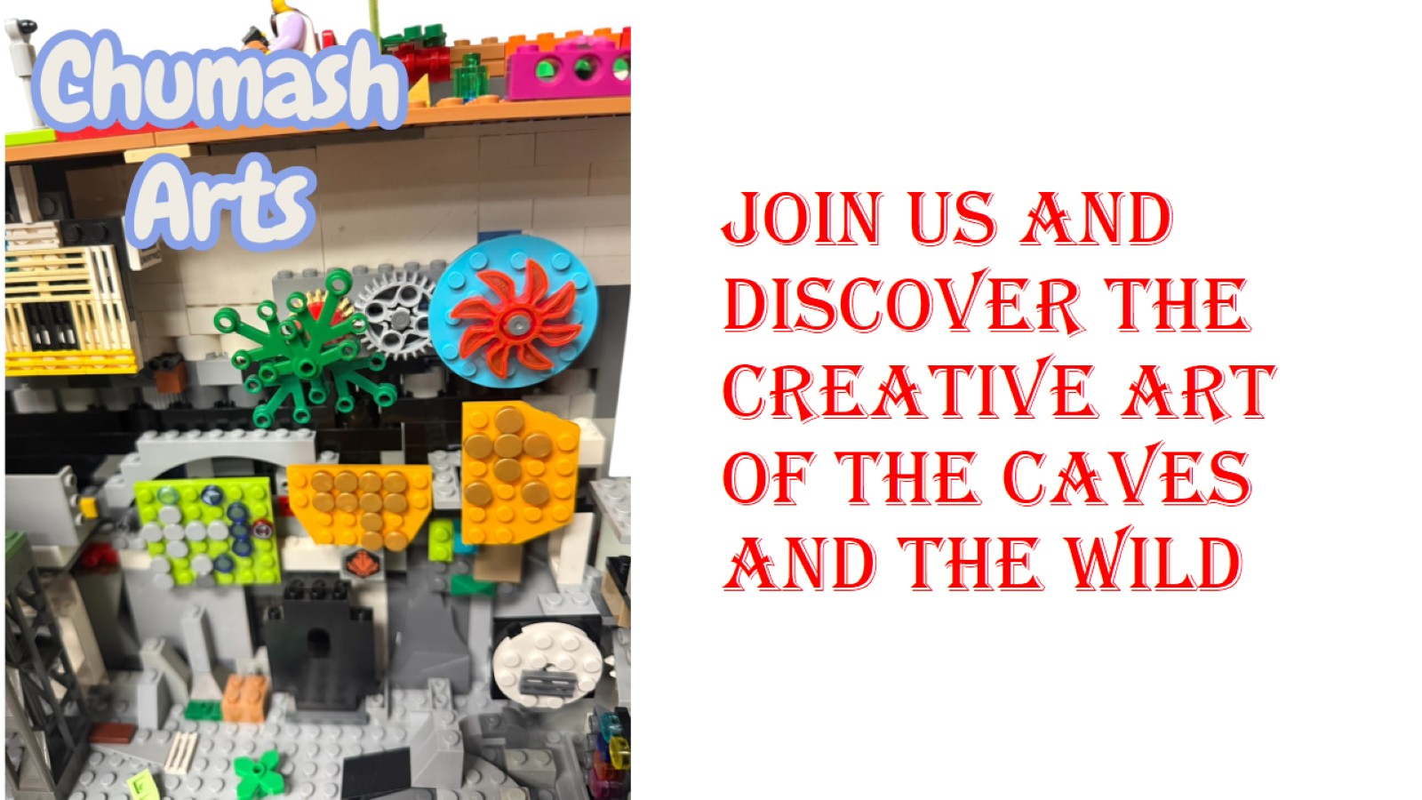
Join us and discover the creative art of the caves and the wild

Slide 17
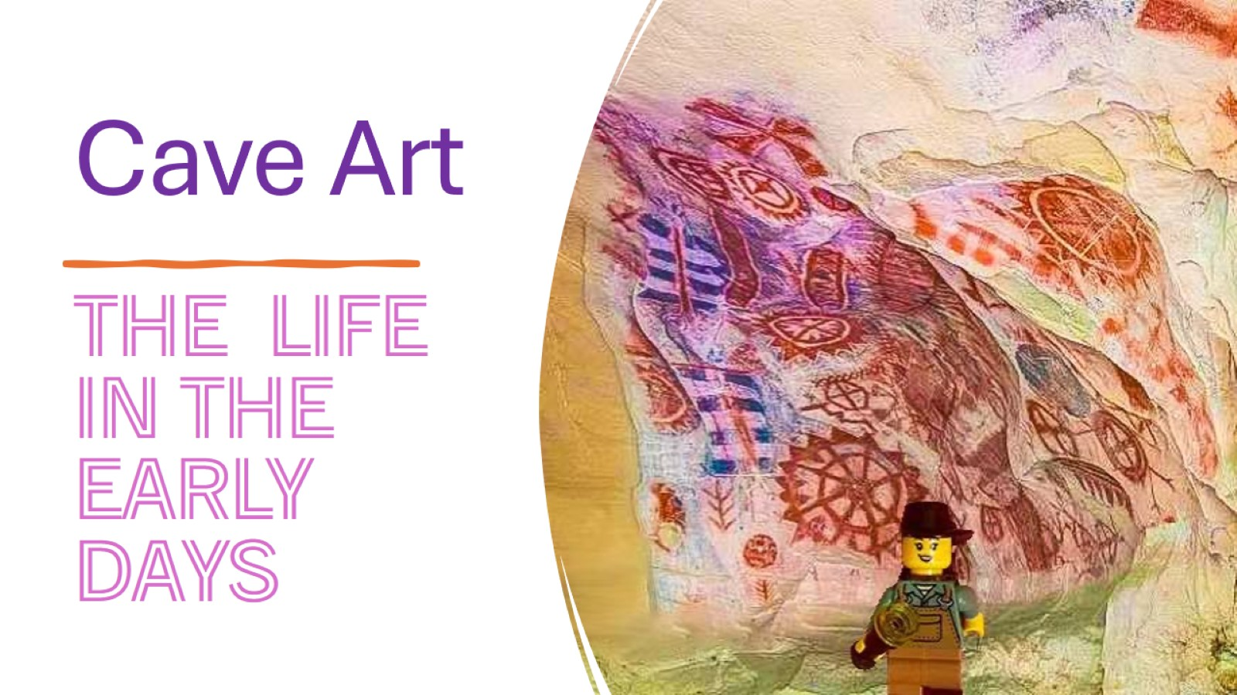
Cave Art

Slide 18
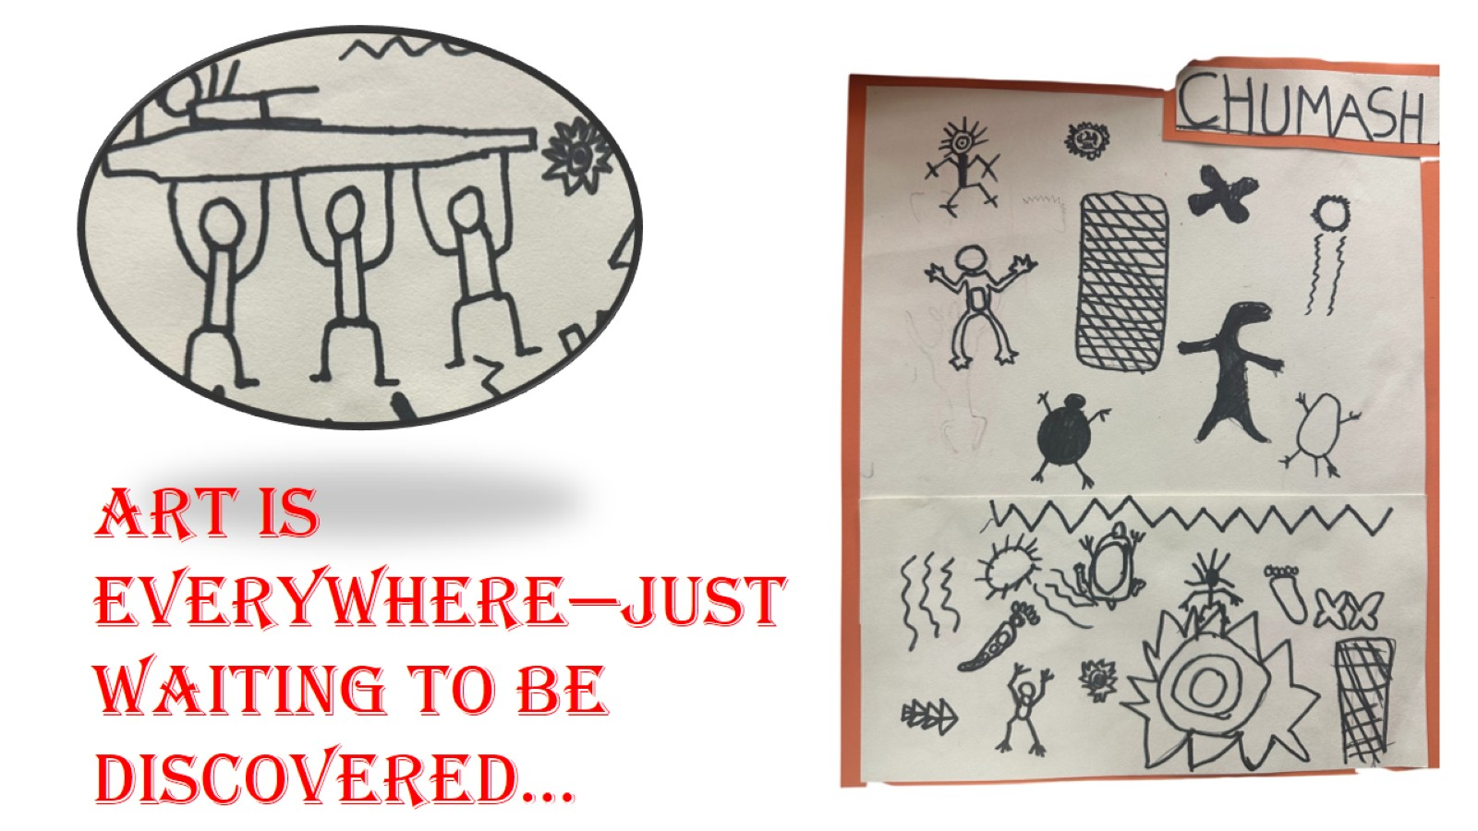

Slide 19
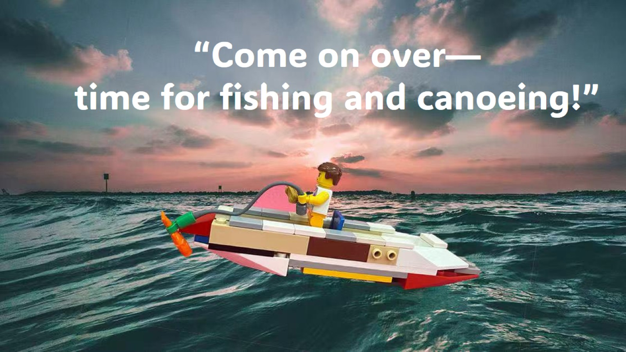

Slide 20
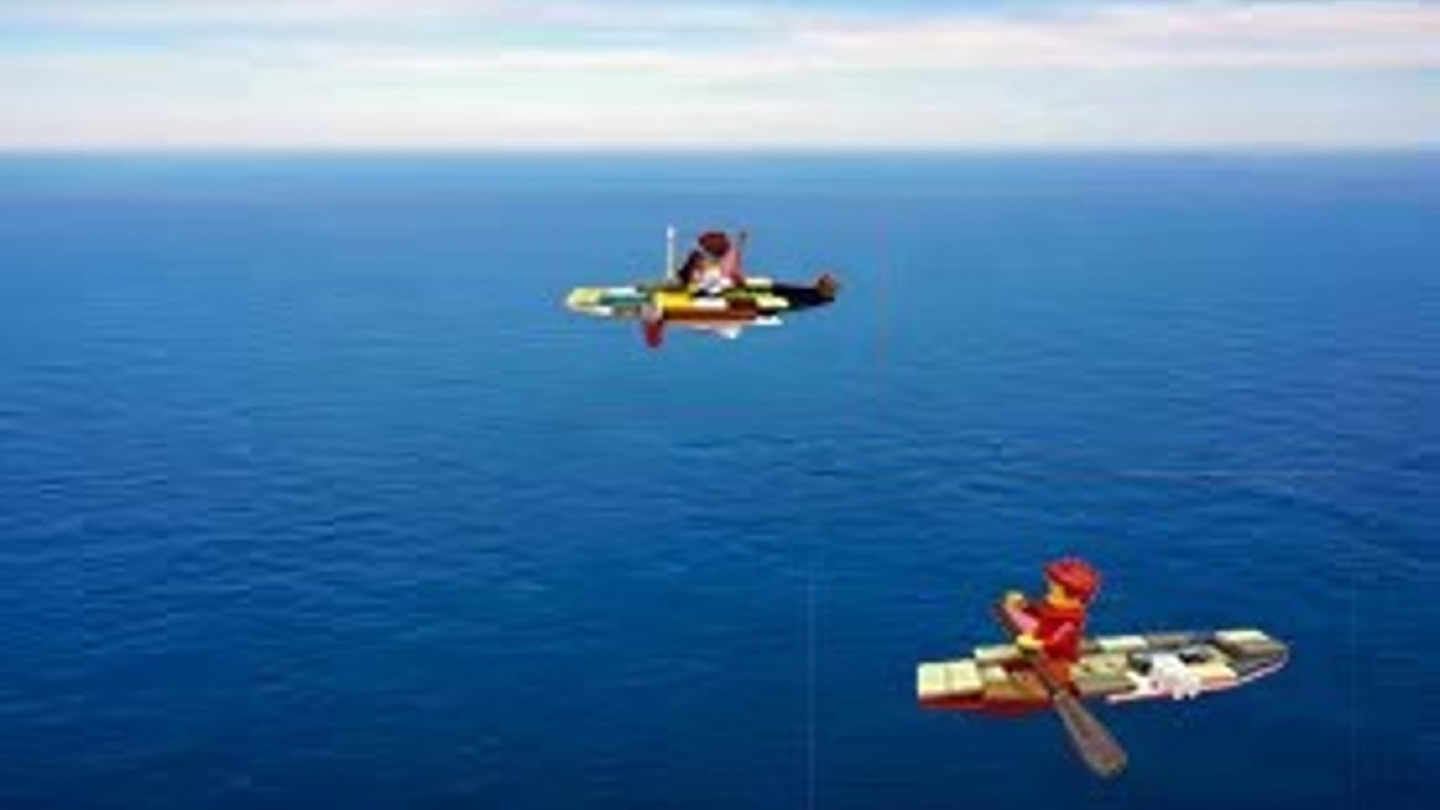

Slide 21


Slide 22
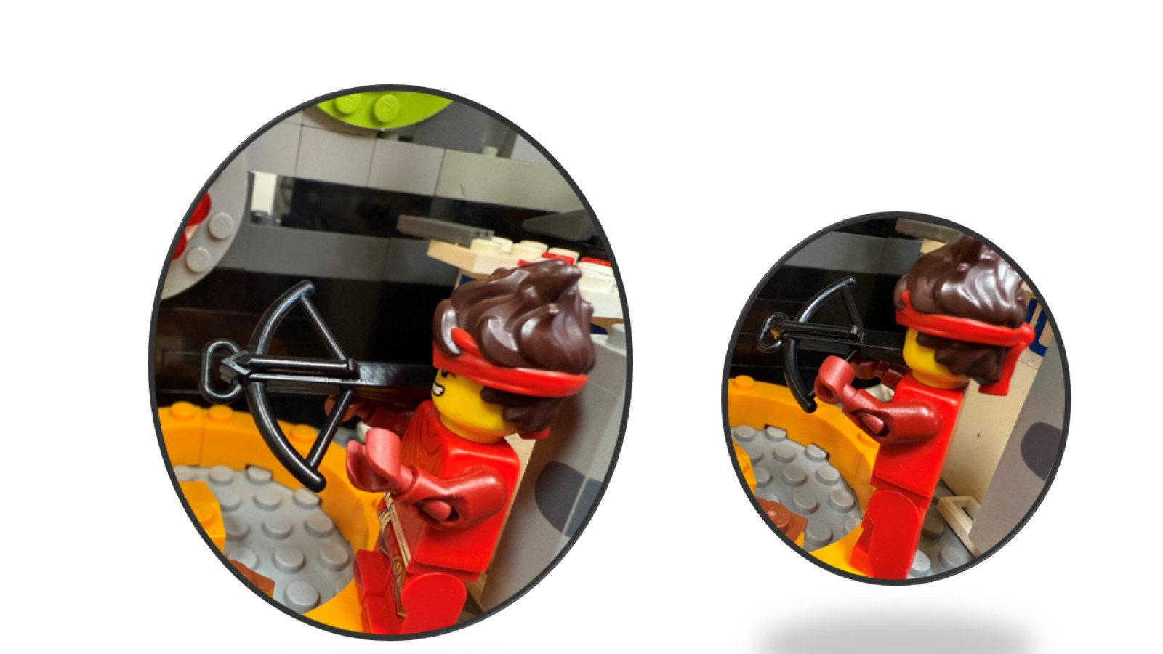

Slide 23
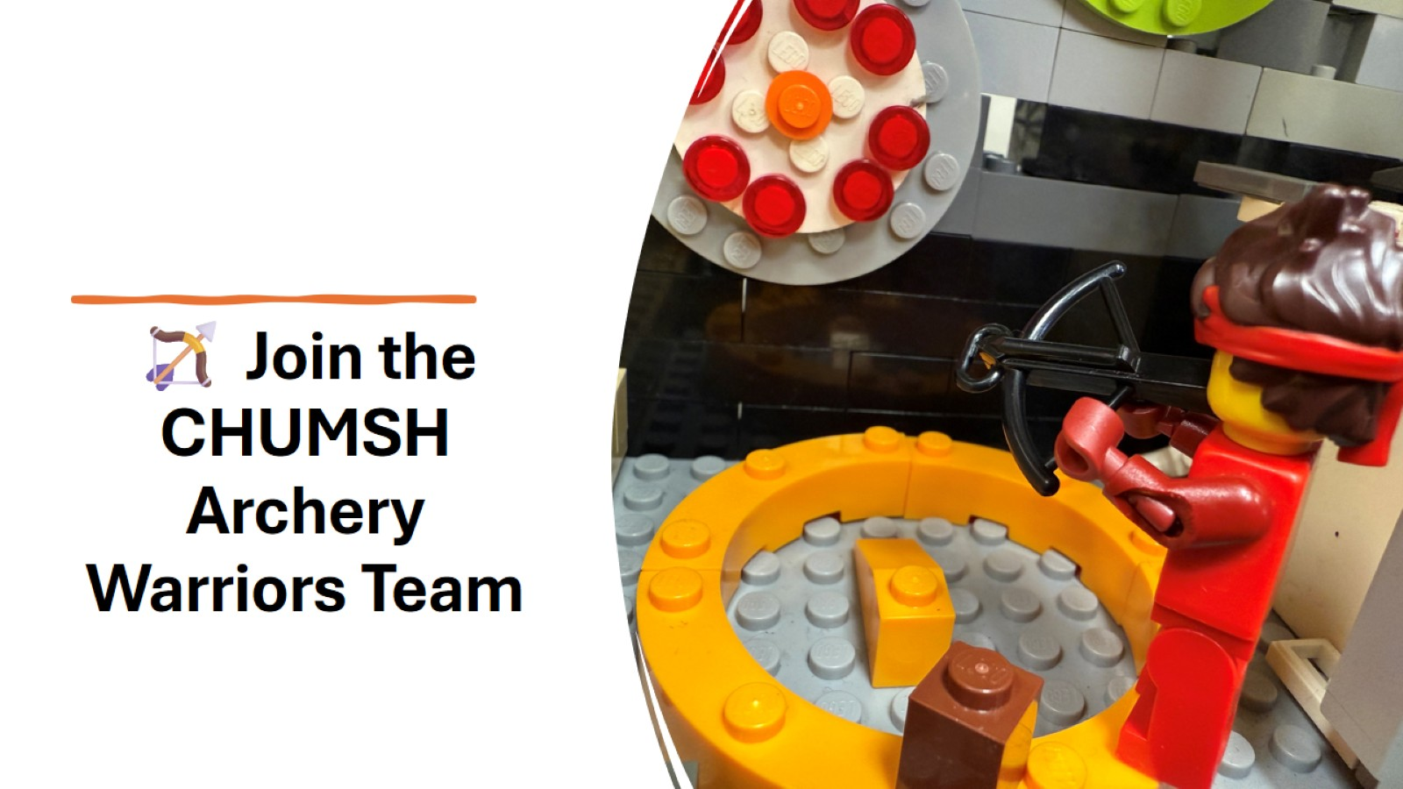
🏹 Join the CHUMSH Archery Warriors Team

Slide 24
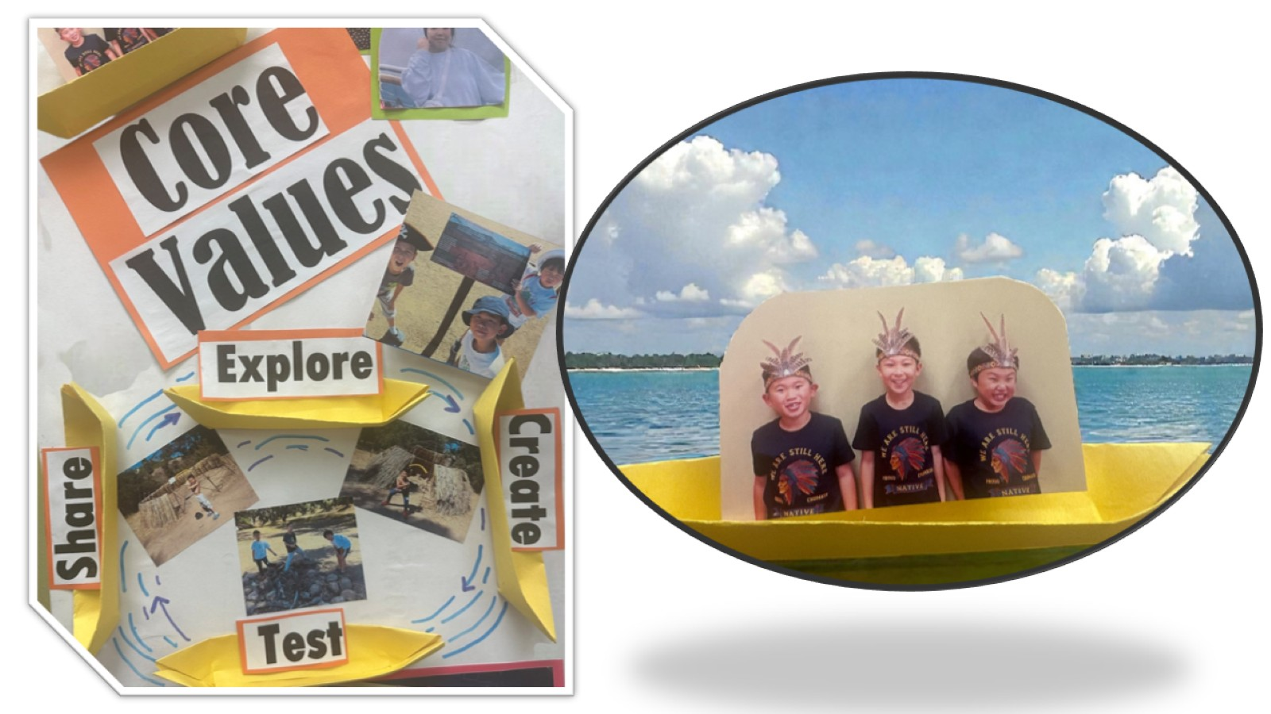

Slide 25
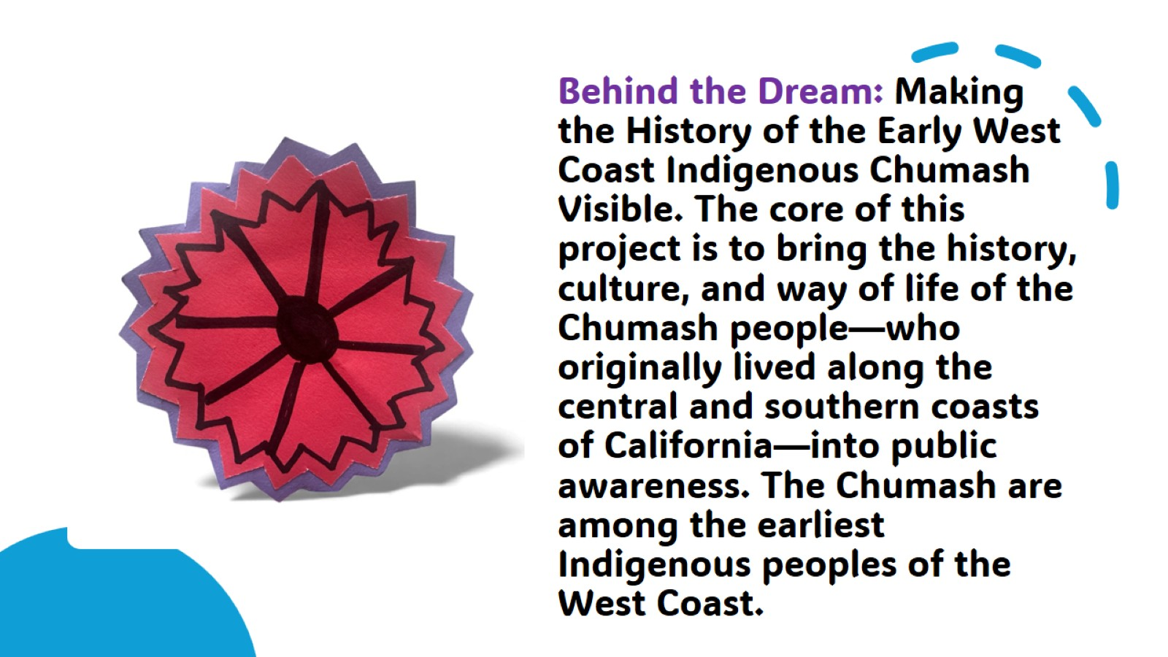

Slide 26
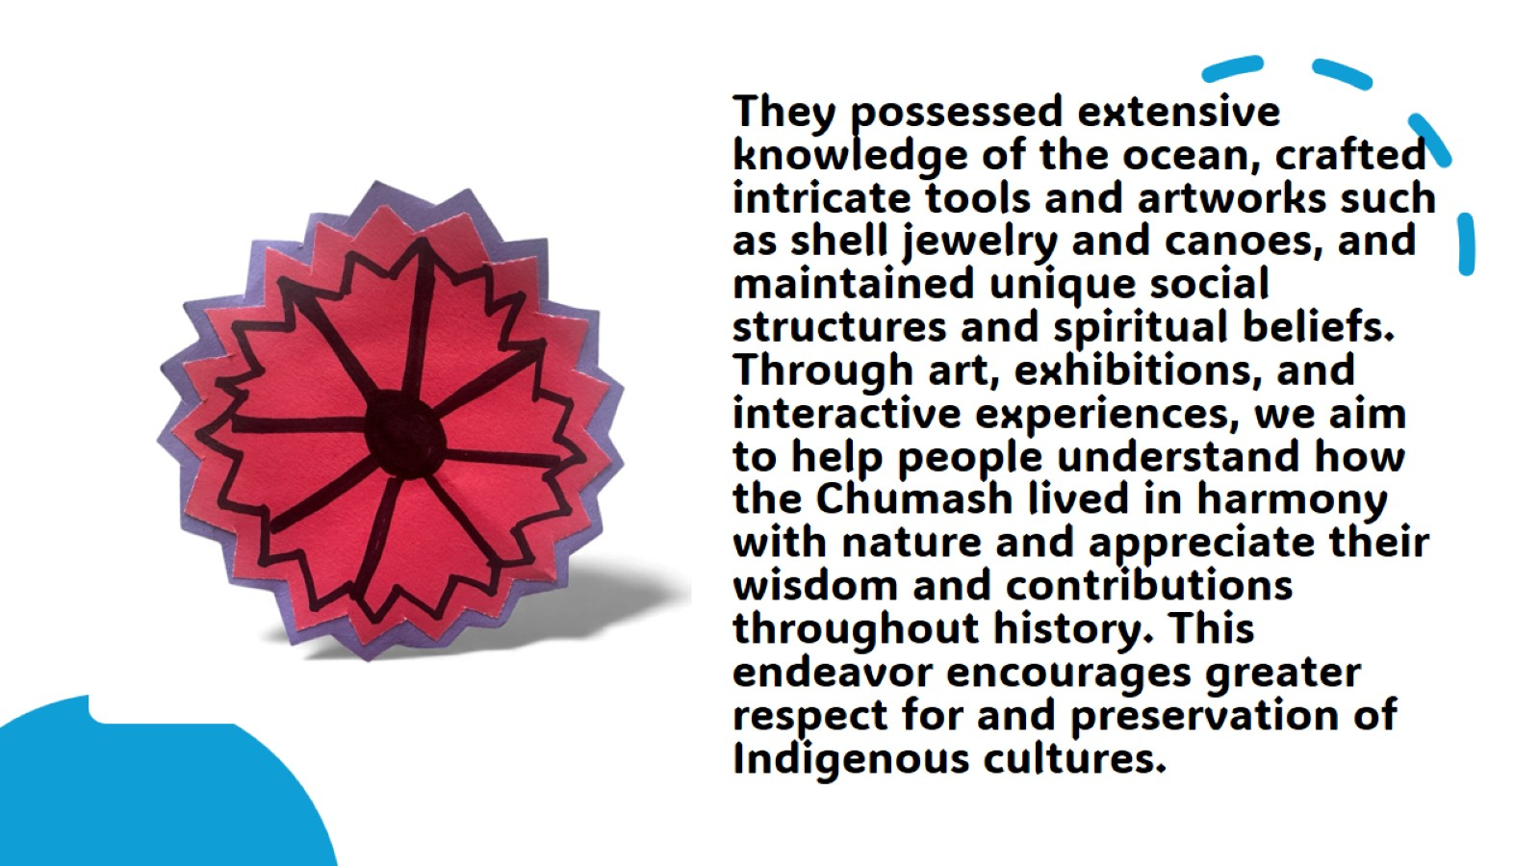

Slide 27
